Slide 1
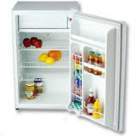
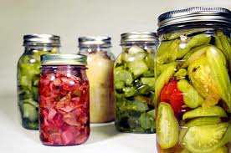
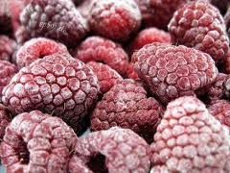
Food Preservation Technology
Ch. 28

Slide 2
Objectives:
Describe the effect of freezing on foods
Identify and describe commercial freezing methods
Demonstrate how to choose and package foods for freezing at home
Explain the role of sublimation in freeze-drying
Explain how irradiation preserves foods
Assess arguments for and against irradiation
Evaluate the suitability of containers for commercial food packaging
Compare modified-atmosphere packaging with aseptic packaging
Vocabulary:
Electromagnetic spectrum
Electromagnetic waves
Flash frozen
Gray
Immersion freezing
Indirect-contact freezing
Irradiation
Kilogray (kGy)
Lyophilization
Modified-atmosphere packaging (MAP)
Radiation

Slide 3
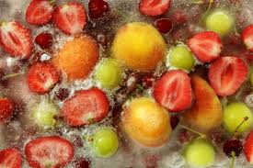
Freezing
Preserves food by slowing the action of enzymes
Prevents the growth of microorganisms
Freezer burn- caused by poor packaging
Commercial freezing includes:
Freezing in air: most common method
Indirect-contact freezing: food chills next to cold wall
Immersion freezing: food submerged in refrigerant

Slide 4
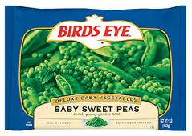
Freezing example
Home freezing
Foods with high water content lose shape when frozen (fruits and vegetables)
Seasonings such as basil turn bitter in the freezer
Typical frozen foods last 6-12 months in freezer

Slide 5
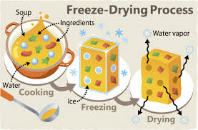
Freeze-drying
Commercial process that combines freezing and drying to preserve food
Technical name: Lyophilization
Sublimation- ice changes from solid to gas, leaving dried food
Flash freeze- frozen very quickly

Slide 6
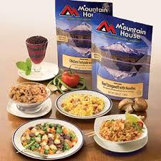
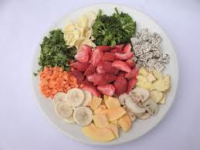
Freeze-drying example
Used with mushrooms, strawberries, chicken
Can be stored for months or years
Freeze dried products are lightweight
Food reconstituted before it’s eaten

Slide 7
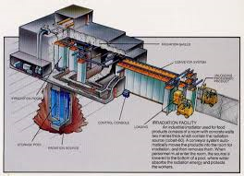
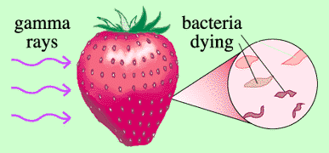
Irradiation
Food is exposed to a controlled amount of radiation for a specific time
Destroys organisms that would cause spoilage
Amount of radiation measured in grays
More radiation, the greater the preservative effect

Slide 8
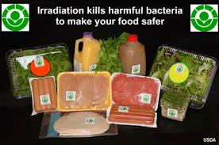
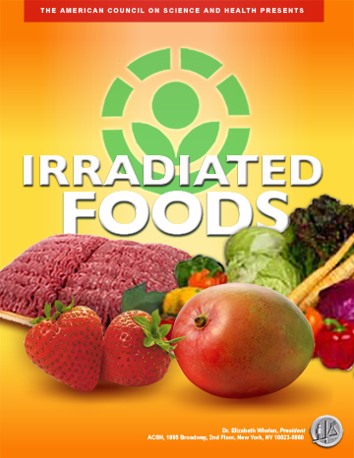
Irradiation example
Potatoes and onions have been treated to inhibit sprouting
Irradiated mushrooms have less deterioration
Gives food a longer shelf life
Poultry and beef has decreased E. coli

Slide 9
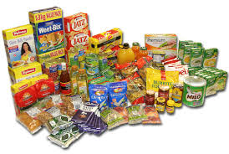
Packaging
Safety- nontoxic, sanitary, sturdy
Food quality- protect food from light/odors
Convenience- opened easily, resealable
Expense- lower cost
Environmentally safe- recyclable
Marketing appeal- attractive to consumers

Slide 10
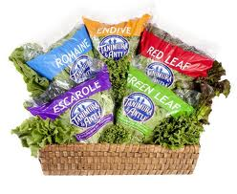
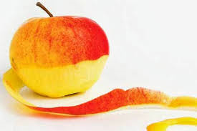
Packaging example
Modified-atmosphere packaging (MAP)- creates gaseous environment for food
Aseptic packaging- store beverages/liquid foods that were aseptically processed
Edible films/wraps- natural biodegradable film for example apple skin

Slide 11
Conclusion video
(3:14 minutes)
http://youtu.be/r-aP9wEeCr0

